Slide 1
Spread Spectrum
Chapter 4

Slide 2
Spread Spectrum
Input is fed into a channel encoder
  Produces analog signal with narrow bandwidth
Signal is further modulated using sequence of digits
  Spreading code or spreading sequence
  Generated by pseudonoise, or pseudo-random number generator
Effect of modulation is to increase bandwidth of signal to be transmitted

Slide 3
Spread Spectrum
On receiving end, digit sequence is used to demodulate the spread spectrum signal
Signal is fed into a channel decoder to recover data

Slide 4
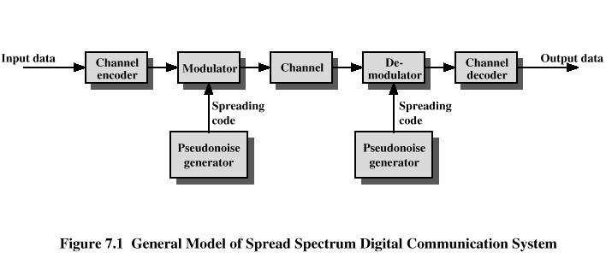
Spread Spectrum

Slide 5
Spread Spectrum
What can be gained from apparent waste of spectrum?
  Immunity from various kinds of noise and multipath distortion
  Can be used for hiding and encrypting signals
  Several users can independently use the same higher bandwidth with very little interference

Slide 6
Direct Sequence Spread Spectrum (DSSS)
Each bit in original signal is represented by multiple bits in the transmitted signal
Spreading code spreads signal across a wider frequency band
  Spread is in direct proportion to number of bits used
One technique combines digital information stream with the spreading code bit stream using exclusive-OR (Figure 7.6)

Slide 7
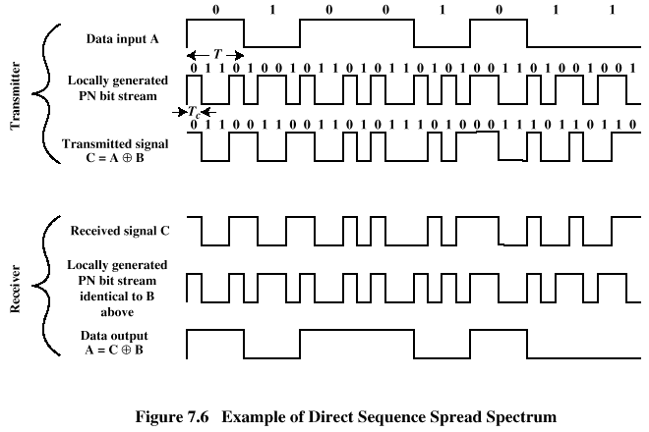
Direct Sequence Spread Spectrum (DSSS)

Slide 8
DSSS Using BPSK
Multiply BPSK signal,
  s_{d}(t) = A d(t) cos(2π f_{c}t)
by c(t) [takes values +1, -1] to get
  s(t) = A d(t)c(t) cos(2π f_{c}t)
    A = amplitude of signal
    f_{c} = carrier frequency
    d(t) = discrete function [+1, -1]
At receiver, incoming signal multiplied by c(t)
  Since, c(t) × c(t) = 1, incoming signal is recovered

Slide 9
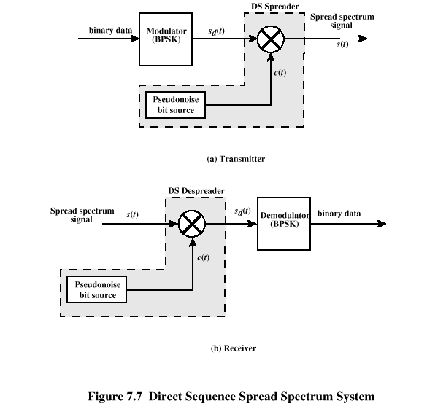
DSSS Using BPSK

Slide 10
Code-Division Multiple Access (CDMA)
Basic Principles of CDMA
  D = rate of data signal
  Break each bit into k chips
    Chips are a user-specific fixed pattern
  Chip data rate of new channel = kD

Slide 11
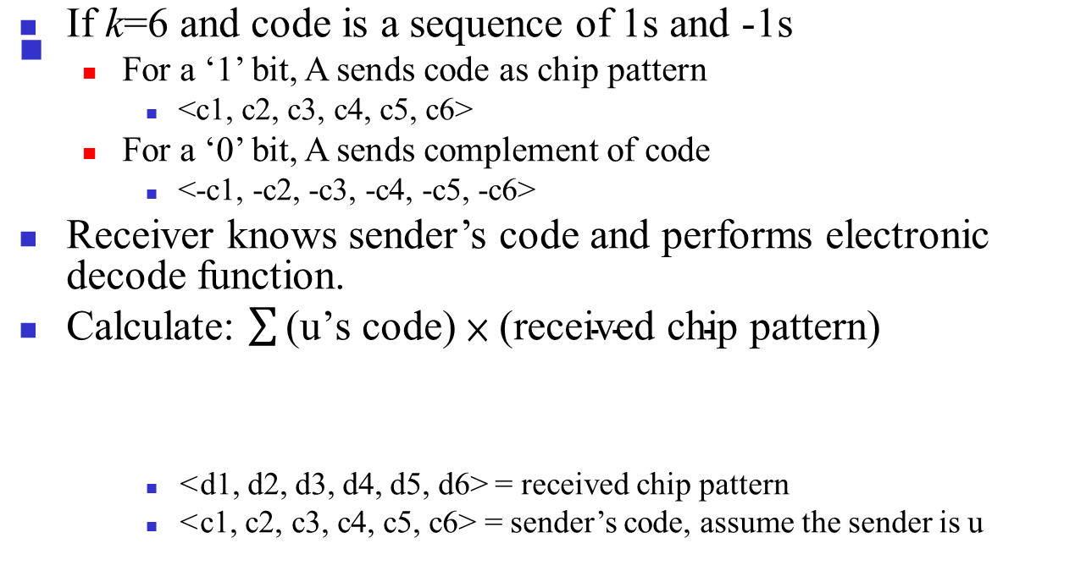
CDMA Example

Slide 12
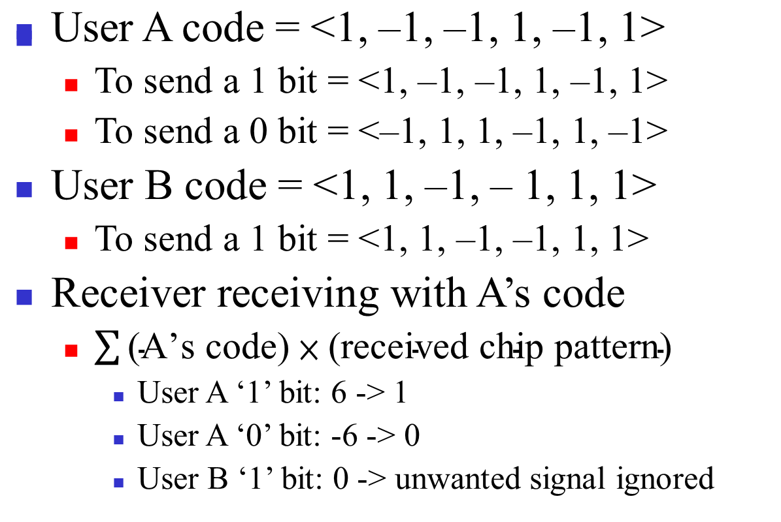
CDMA Example

Slide 13
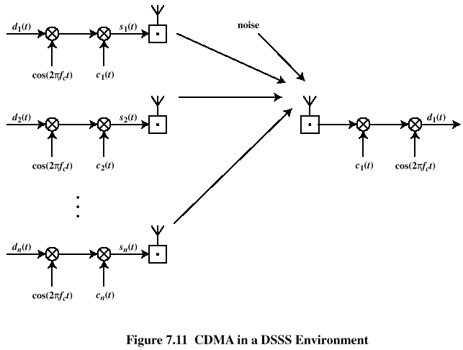
CDMA for Direct Sequence Spread Spectrum

Slide 14
Frequency Hoping Spread Spectrum (FHSS)
Signal is broadcast over seemingly random series of radio frequencies
  A number of channels allocated for the FH signal
  Width of each channel corresponds to bandwidth of input signal
Signal hops from frequency to frequency at fixed intervals
  Transmitter operates in one channel at a time
  Bits are transmitted using some encoding scheme
  At each successive interval, a new carrier frequency is selected

Slide 15
Frequency Hoping Spread Spectrum
Channel sequence dictated by spreading code
Receiver, hopping between frequencies in synchronization with transmitter, picks up message
Advantages
  Eavesdroppers hear only unintelligible blips
  Attempts to jam signal on one frequency succeed only at knocking out a few bits

Slide 16
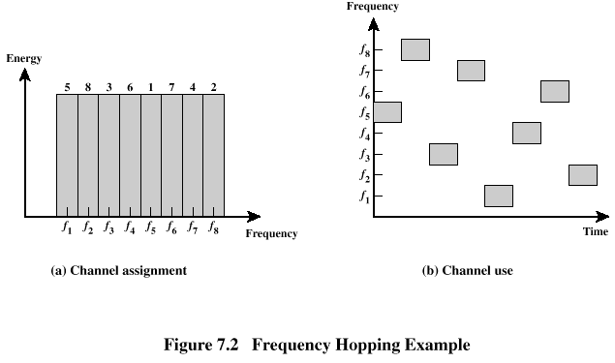
Frequency Hoping Spread Spectrum

Slide 17
FHSS Using MFSK
MFSK signal is translated to a new frequency every T_{c} seconds by modulating the MFSK signal with the FHSS carrier signal
For data rate of R:
  duration of a bit: T = 1/R seconds
  duration of signal element: T_{s} = LT seconds
T_{c} ≥ T_{s} - slow-frequency-hop spread spectrum
T_{c} < T_{s} - fast-frequency-hop spread spectrum

Slide 18
FHSS Performance Considerations
Large number of frequencies used
Results in a system that is quite resistant to jamming
  Jammer must jam all frequencies
  With fixed power, this reduces the jamming power in any one frequency band

Slide 19
Categories of Spreading Sequences
Spreading Sequence Categories
  PN sequences
  Orthogonal codes
For FHSS systems
  PN sequences most common
For DSSS systems not employing CDMA
  PN sequences most common
For DSSS CDMA systems
  PN sequences (all unwanted users act like random noise to the target user)
  Orthogonal codes (all unwanted users can be completed removed at the receiver)

Slide 20
PN Sequences
PN generator produces periodic sequence that appears to be random (so that they appear not related to the target user)
PN Sequences
  Generated by an algorithm using initial seed
  Sequence isn’t statistically random but will pass many test of randomness
  Sequences referred to as pseudorandom numbers or pseudonoise sequences
  Unless algorithm and seed are known, the sequence is impractical to predict

Slide 21
Important PN Properties
Randomness
  Uniform distribution
    Balance property
    Run property
  Independence
  Correlation property
Unpredictability

Slide 22
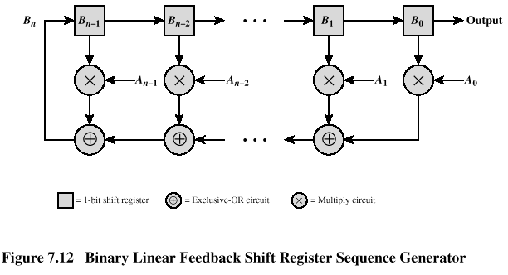
Linear Feedback Shift Register Implementation

Slide 23
Properties of M-Sequences
Property 1:
  Has 2^{n-1} ones and 2^{n-1}-1 zeros
Property 2:
  For a window of length n slid along output for N (=2^{n-1}) shifts, each n-tuple appears once, except for the all zeros sequence
Property 3:
  Sequence contains one run of ones, length n
  One run of zeros, length n-1
  One run of ones and one run of zeros, length n-2
  Two runs of ones and two runs of zeros, length n-3
  2^{n-3} runs of ones and 2^{n-3} runs of zeros, length 1

Slide 24
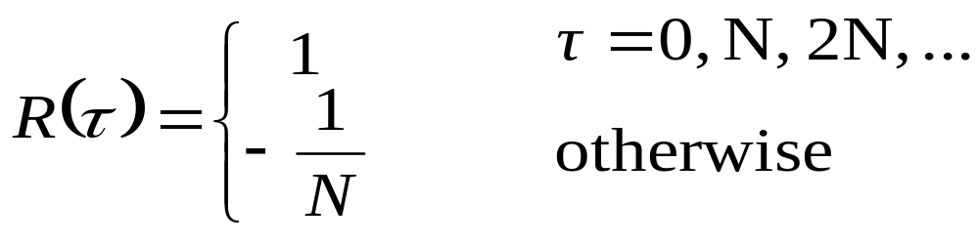
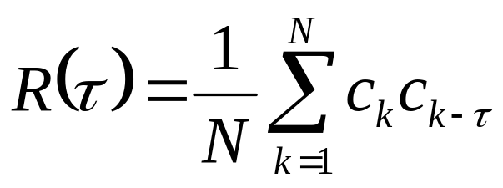
Properties of M-Sequences
Property 4:
  The periodic autocorrelation of a ±1 m-sequence is
  where autocorrelation is defined as

Slide 25
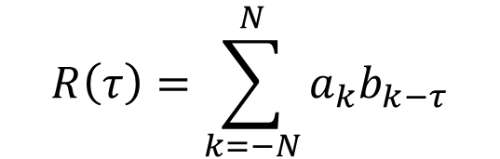


Definitions
Sequence
Correlation:
  The concept of determining how much similarity one set of data has with another
  Range between –1 and 1
    1 The second sequence matches the first sequence
    0 There is no relation at all between the two sequences
    -1 The two sequences are mirror images
Autocorrelation
  The correlation of a sequence with all phases of itself
Cross correlation
  The comparison between two sequences from different sources rather than a shifted copy of a sequence with itself
Sequence

Slide 26
Advantages of Cross Correlation
The cross correlation between an m-sequence and noise is low
  This property is useful to the receiver in filtering out noise
The cross correlation between two different m-sequences is low
  This property is useful for CDMA applications
  Enables a receiver to discriminate among spread spectrum signals generated by different m-sequences

Slide 27
Gold Sequences
Gold sequences constructed by the XOR of two m-sequences with the same clocking
Codes have well-defined cross correlation properties
Only simple circuitry needed to generate large number of unique codes
In following example (see Figure (a)) two shift registers generate the two m-sequences and these are then bitwise XORed

Slide 28
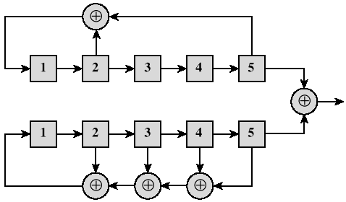
Gold Sequences

Slide 29
Orthogonal Codes
Orthogonal codes
  All pairwise cross correlations are zero
  Fixed- and variable-length codes used in CDMA systems
  For CDMA application, each mobile user uses one sequence in the set as a spreading code
    Provides zero cross correlation among all users
Types
  Welsh codes
  Variable-Length Orthogonal codes

Slide 30
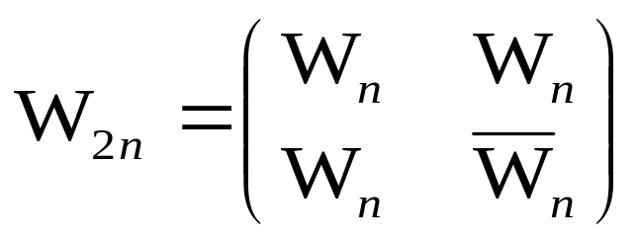
Walsh Codes
Set of Walsh codes of length n consists of the n rows of an n × n Walsh matrix:
  W₁ = (0)
    n = dimension of the matrix
  Every row is orthogonal to every other row and to the logical not of every other row
  Requires tight synchronization
    Cross correlation between different shifts of Walsh sequences is not zero

Slide 31
Typical Multiple Spreading Approach
Spread data rate by an orthogonal code (channelization code)
  Provides mutual orthogonality among all users in the same cell
Further spread result by a PN sequence (scrambling code)
  Provides mutual randomness (low cross correlation) between users in different cells

